Slide 1
Restart a Windows Service
Using BMC Helix Intelligent Automation and TrueSight Orchestration
Sayan Banerjee
Solution Engineering Architect Lead (SEAL) Team
Ipsita Priyadarshini (Consulting Services/PS Team)
April 20th 2023
Version 1.0

Slide 2

Agenda
Overview
Use Case
TSO EO Runbook Configuration
Intelligent Automation Configuration
End-to-End use case
References
© Copyright 2023 BMC Software, Inc.

Slide 3
Overview
PATROL® Agent TSOM and BHOM
This presentation gives a holistic view of the Windows Service Restart Use Case demonstration
Modules and Adapters to enable at TSO end
Steps to configure the Intelligent Automation Policy
This is a preview of the Detailed Video Recording of the Use Case

Slide 4
Use Case
PATROL® Agent TSOM and BHOM
When a Windows Service down alert comes in BHOM, the service is restarted automatically using Intelligent Automation.
In this use case we are using TSO as the automation tool with Intelligent Automation.
OOTB TSO Event Orchestration Runbook adapters and modules are used.
The Intelligent Automation Policy triggers the TSO workflow to remotely restart the Windows service.
The Windows service gets restarted successfully and the event is closed in BHOM.
For the purpose of this Use Case, we are restarting the Print Spooler service on a Windows Server.

Slide 5
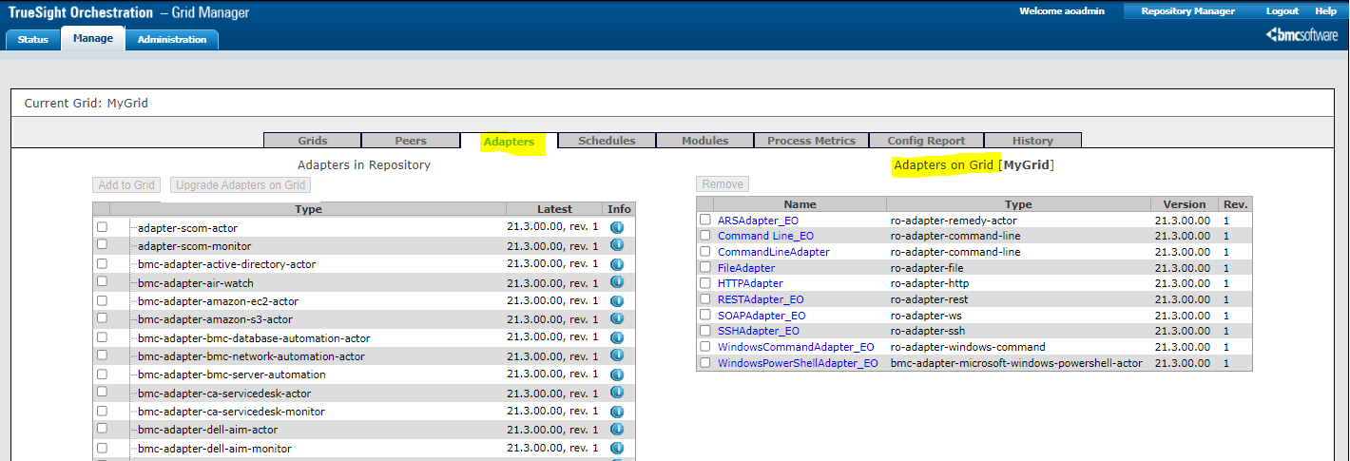
TSO EO Runbook Configuration - 1
PATROL® Agent TSOM and BHOM
Adapters –
Screenshot shows the Adapters needed for this Use Case
Reference - https://docs.bmc.com/docs/TruesightOrchestrationContent/231/installing-the-event-orchestration-runbook-1192637229.html

Slide 6
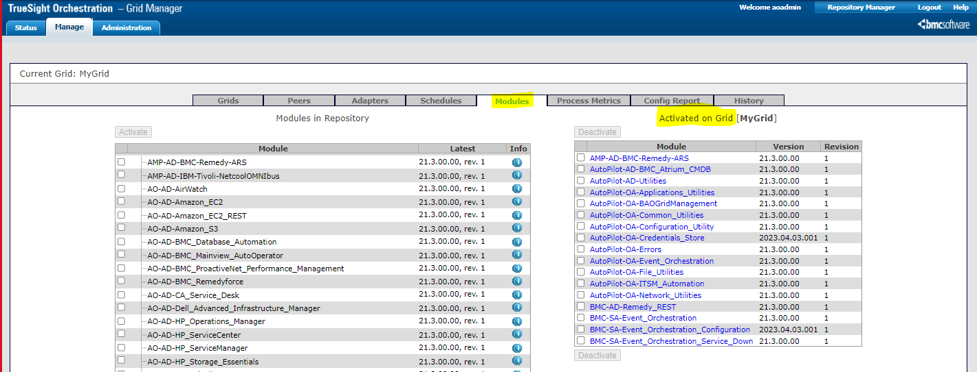
TSO EO Runbook Configuration - 2
PATROL® Agent TSOM and BHOM
Modules –
Screenshot shows the Modules which should be activated for this Use Case
Reference - https://docs.bmc.com/docs/TruesightOrchestrationContent/231/installing-the-event-orchestration-runbook-1192637229.html

Slide 7
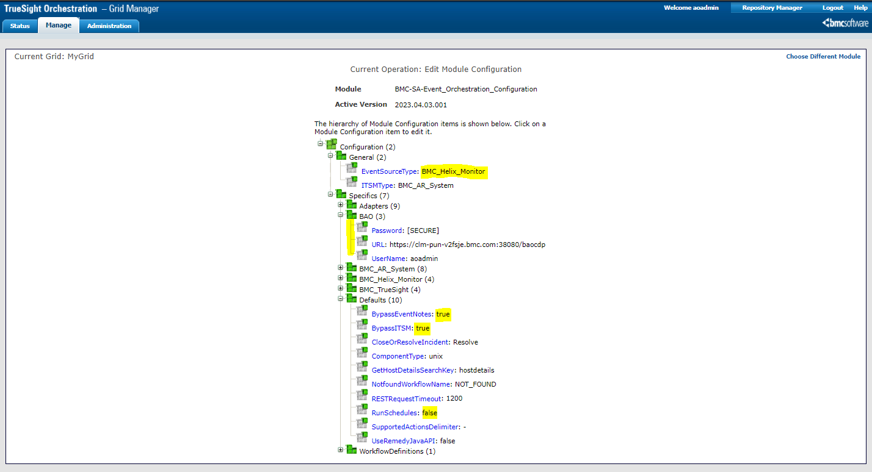
TSO EO Runbook Configuration - 3
PATROL® Agent TSOM and BHOM
Event Orchestration Module configuration – Specific to BMC Helix Monitor
Please make respective changes for the highlighted attributes

Slide 8
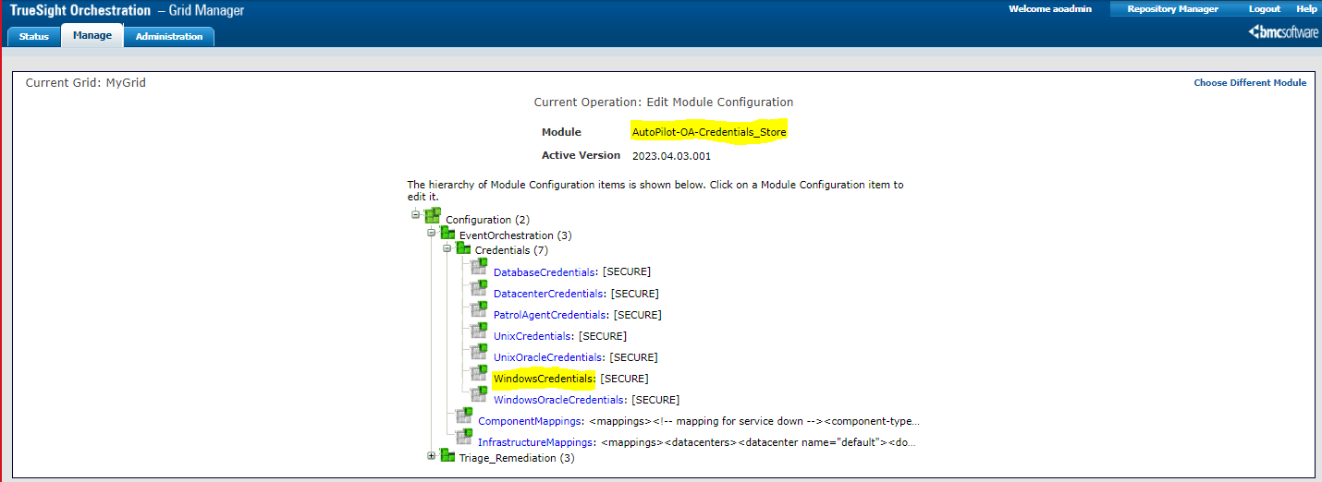
TSO EO Runbook Configuration - 4
PATROL® Agent TSOM and BHOM
Credential Store module configuration – Should have the correct windows credentials

Slide 9
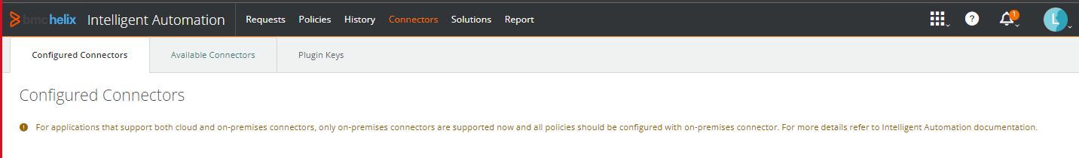
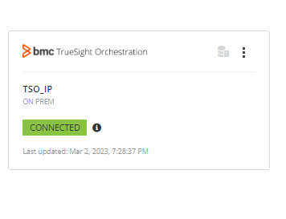
Intelligent Automation – TSO Connector
PATROL® Agent TSOM and BHOM
Screenshot shows the Intelligent Automation (IA) Connector which needs to be configured from the IA console – Connectors Tab

Slide 10
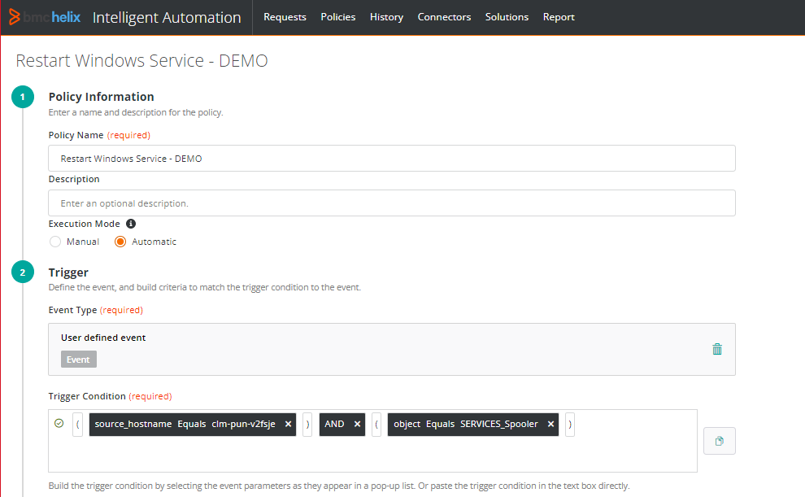
Intelligent Automation – Policy Configuration 1
PATROL® Agent TSOM and BHOM

Slide 11
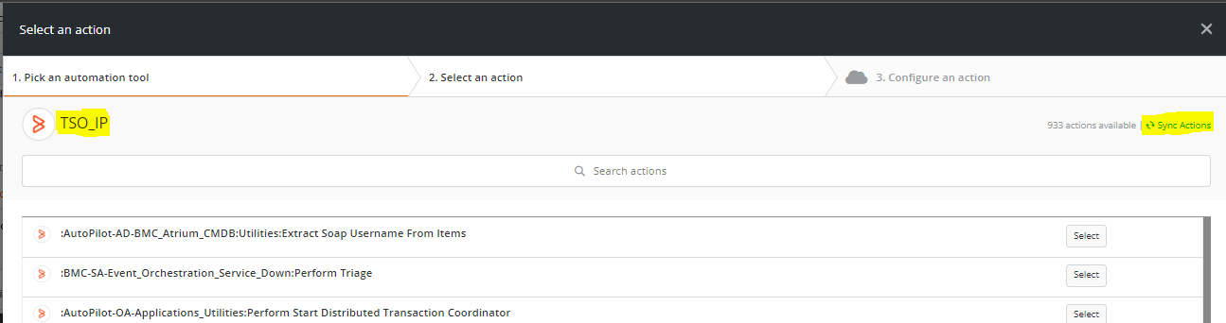



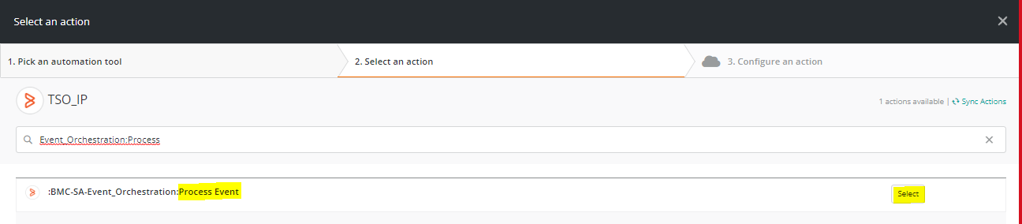

Intelligent Automation – Policy Configuration 2
PATROL® Agent TSOM and BHOM

Slide 12
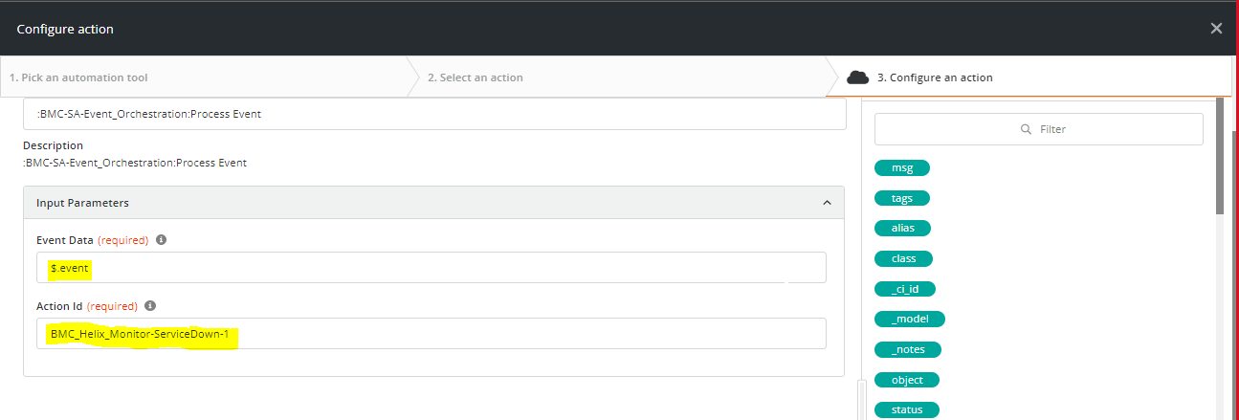
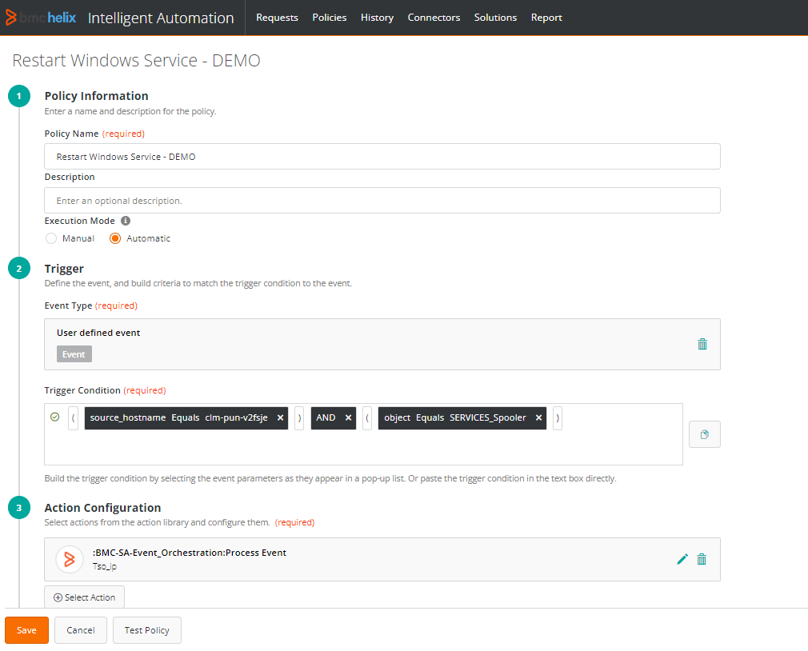
Intelligent Automation – Policy Configuration 3
PATROL® Agent TSOM and BHOM

Slide 13
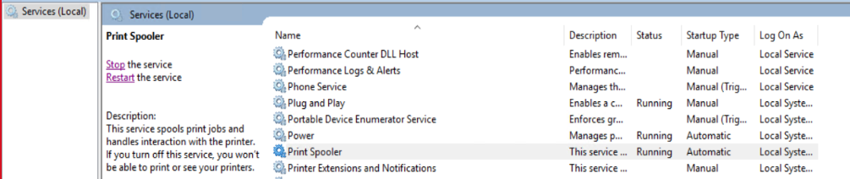
End-to-End Use Case
PATROL® Agent TSOM and BHOM
Print Spooler service goes down on a Windows Server.
Event raised at BHOM. In parallel Intelligent Automation Policy triggers (DEMO)
IA Policy executed successfully.
Print Spooler service restarted automatically on the Windows Server and the event got closed in BHOM

Slide 14
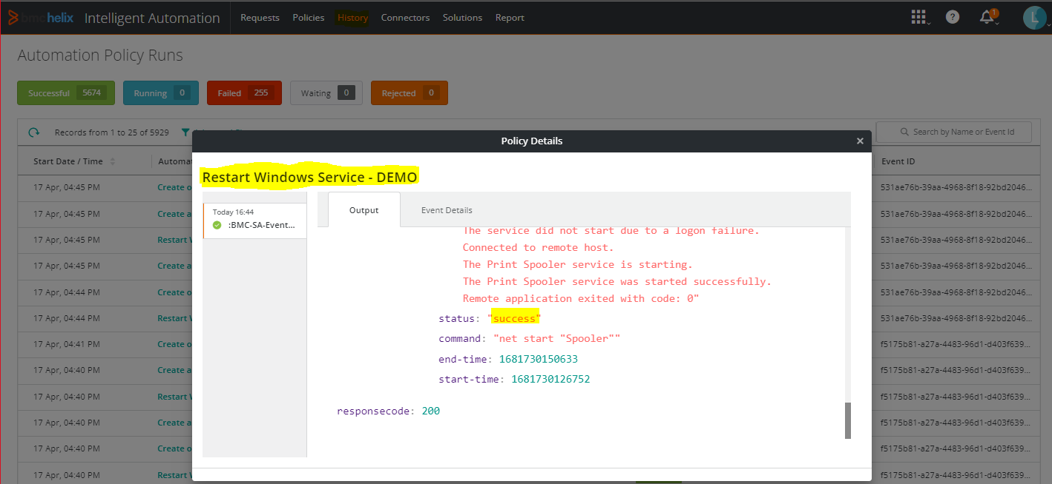
Intelligent Automation – Policy Execution History
PATROL® Agent TSOM and BHOM
Shows successful execution of IA policy in restarting the service

Slide 15
References
BMC Helix Operations Management deployment for On-Prem
https://docs.bmc.com/docs/itomdeploy23102/home-1197511539.html
BMC Education
https://www.bmc.com/education/training-and-certification.html
BMC Helix Operations Management
https://docs.bmc.com/docs/helixoperationsmanagement/232/home-1195093435.html
BMC Helix AIOps
https://docs.bmc.com/docs/helixaiops/231/home-1161784950.html
BMC Patrol Agent 23.1 for BHOM
https://docs.bmc.com/docs/display/PABHOM231/Migrating+PATROL+Agents
Udemy & Linux Foundation Certified Kubernetes Administrator
https://www.udemy.com/course/certified-kubernetes-administrator-with-practice-tests
https://training.linuxfoundation.org/certification/certified-kubernetes-administrator-cka/

Slide 16
DEMO

